Slide 1

Transaction Success Prediction
Using Gaussian Naïve Bayes to classify financial transactions
Abraham De Vargas · Deep Dive Data Science Cohort-20 · 03/20/2026
Notes:
Hello everyone, I’m Abraham. My project is on predicting whether a bank transaction will succeed using Gaussian Naive Bayes. Let me walk you through the problem, the data, how I built and evaluated the model, and the key lesson about why balancing your data matters.

Slide 2
What We'll Cover
01
02
03
04
The Problem
The Data
Model & Results
Key Takeaway
Binary classification of transactions
180K labeled rows, 51 features
Gaussian Naïve Bayes, CV accuracy
Why balancing data matters
Notes:
Here’s what I’ll cover - the business problem, the data I worked with, the model and results, and the key takeaway about why data balancing matters.

Slide 3
The Problem
Will this customer make a transaction?
Supervised binary classification
Target: 1 = transaction, 0 = no transaction
Model: Gaussian Naïve Bayes
100 anonymized predictor variables
180,000 labeled rows out of 1,050,000
1,050,000
total rows in raw dataset
180K
~90%
labeled rows
non-transactions
Notes:
The question I’m trying to answer is simple: will this customer make a transaction or not? That makes it a supervised binary classification problem. The target column tells us the answer - 1 means a transaction happened, 0 means it didn’t. The raw dataset has 1,050,000 rows total, but only 180,000 are labeled - so that’s what I trained on. And of those, about 90% are non-transactions. That class imbalance turns out to be the biggest challenge in the whole project.

Slide 4
Data Cleaning
Data cleaning results
Dropped 870K unlabeled rows - no target, unusable for supervised learning
Dropped 51 fully null predictor columns
Imputed remaining nulls with median
180k rows & 51 features
51
870,000
ready to use
null columns dropped
rows dropped
Notes:
Before I could do anything useful with the data, I had to clean it. Three things happened here. First, I dropped the 870,000 unlabeled rows - they had no target value, so they can’t be used for supervised learning. Second, after removing those rows, 51 of the 100 predictor columns turned out to be entirely null - nothing left in them - so those were dropped too. That left me with 51 usable predictors. Third, any remaining missing values in those predictors were filled in using the column median, which is robust to outliers and skewed distributions. After cleaning I had 180,000 rows and 51 features, ready to explore.

Slide 5
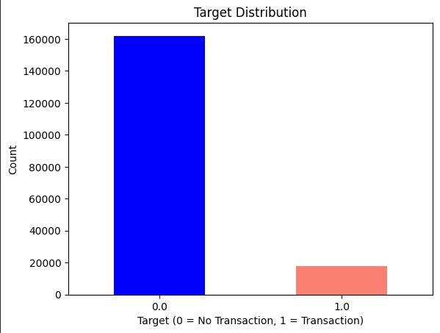
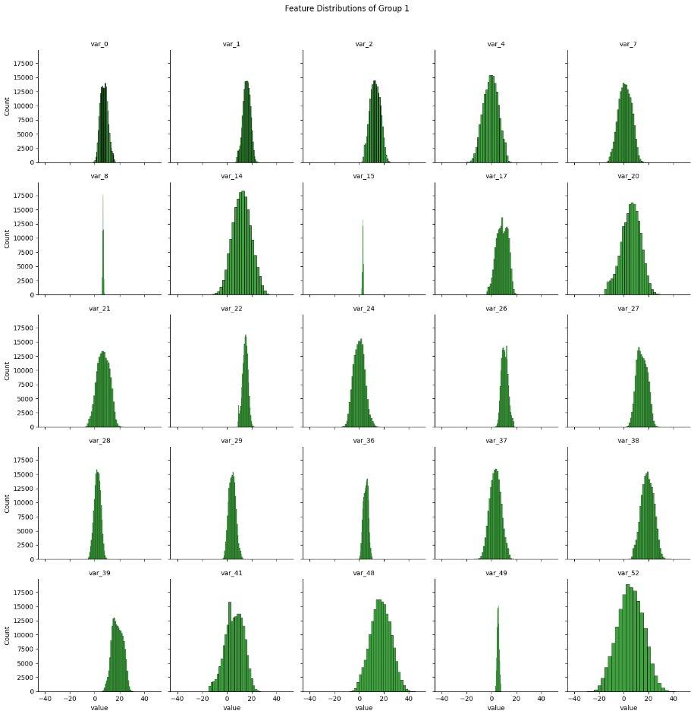
Data & Exploratory Analysis
Class Imbalance
Feature Distributions (approx. Gaussian)
No correlations above |0.8| found between predictors — independence assumption satisfied ✓
Notes:
Now looking at the data that came from AWS S3 - 51 predictor variables after cleaning. You can see the class imbalance clearly in the bar chart on the left - the class 0 bar dwarf’s the class 1 bar. On the right are the feature distributions. Most of them look approximately Gaussian, which is exactly what Naive Bayes needs. Some have mild skew but nothing extreme. I used Gaussian Naive Bayes because the predictors are numeric and approximately normally distributed which is a natural fit for this dataset.

Slide 6
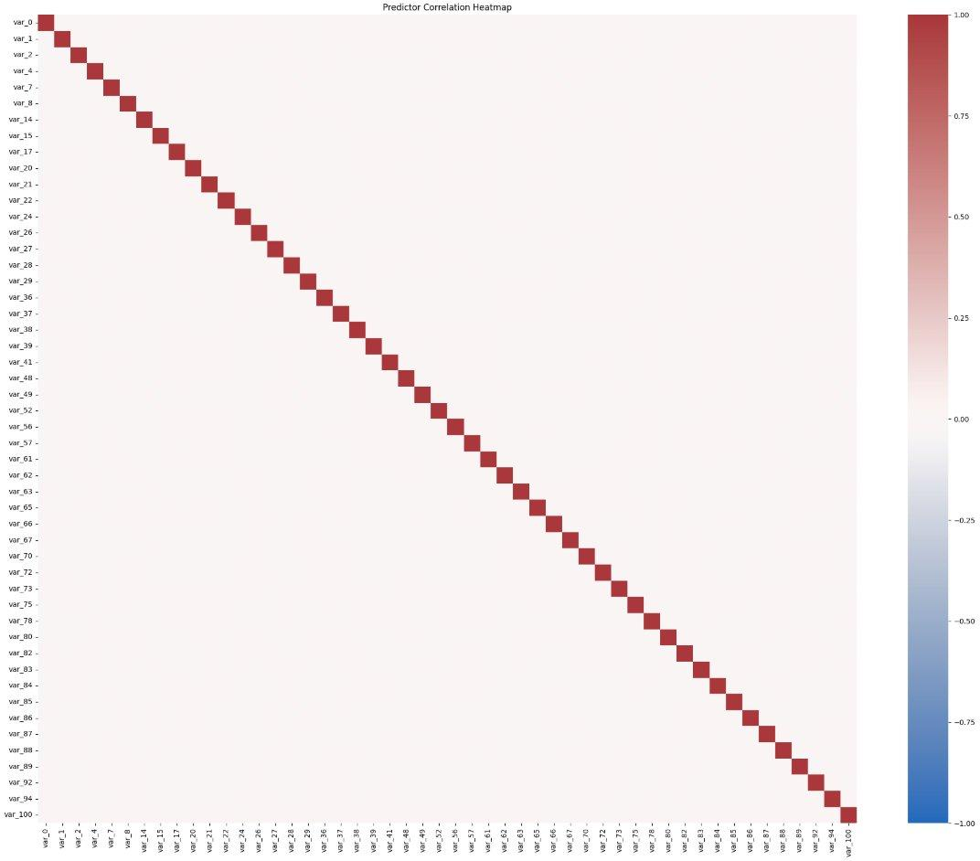
Predictor Independence Check
0 pairs
above |0.8|
Only the diagonal (self-correlation = 1.0) is red
All off-diagonal values near 0
Naïve Bayes independence assumption satisfied
Notes:
Before modeling I checked whether the predictors were correlated with each other - because Naive bayes assumes they’re independent. The heatmap shows only the diagonal is red, meaning those are each variable correlated with itself. Zero pairs had a correlation above 0.8. The independence assumption holds.

Slide 7
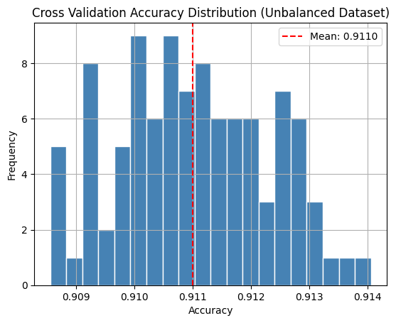
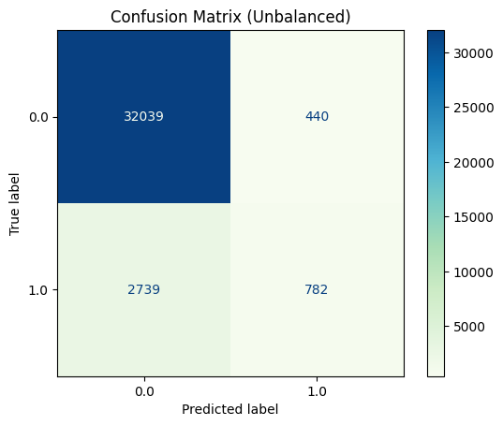
Model Results — Unbalanced Data
CV Accuracy (100 runs)
Confusion Matrix
⚠️ 91% accuracy is misleading — model predicts class 0 almost exclusively. Class 1 recall = 0.23
Notes:
So I built the model. On the unbalanced dataset, the Cross Validation across 100 runs came back at 91% accuracy . That sounds great - but accuracy alone is a trap when your data is imbalance. Look at the confusion matrix. The model predicts class 1 only 782 times out of 3,521 actual class 1 cases. It’s just predicting 0 every time and getting credit for it because 90% of the data is class 0. The classification report confirmed this - class 1 recall was only 0.23. The model was essentially useless for finding actual transactions.

Slide 8
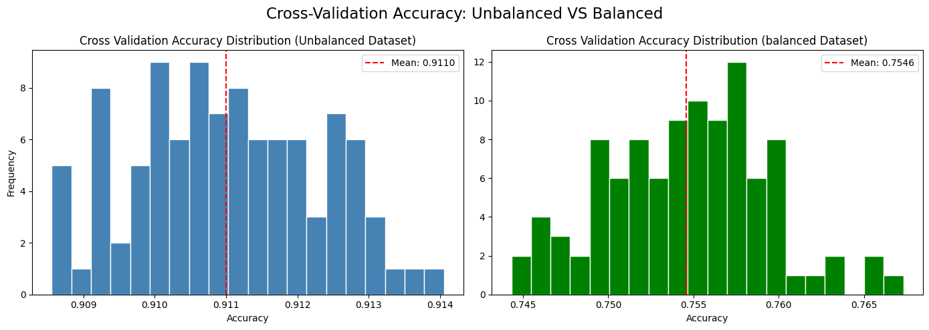
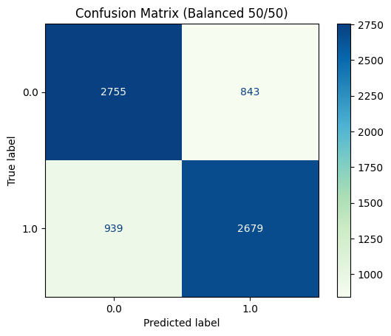
Model Results — Balanced Data (50/50)
CV Accuracy Comparison: Unbalanced vs Balanced
Confusion Matrix (Balanced)
✓ Balanced model: ~75-76% accuracy with 0.74 recall for class 1 and 0.77 for class 0. Precision & F1 ≈ 0.75 across the board.
Notes:
So I fixed it by downsampling class 0 to match the 18,040 class 1 rows - giving a 50/50 split. The side-by-side histogram comparison tells the whole story. Unbalanced clusters around 91% , the balanced drops to 76%. But now look at the confusion matrix - both quadrants on the diagonal are dark blue. The model is actually predicting both classes. Precision and F1 all came in around 0.75 for both classes - nearly identical performance on each. That’s a real model.

Slide 9
Summary & What's Next
Key Takeaways
What's Next
91% accuracy on unbalanced data is deceptive
Balancing data → honest 76% accuracy
Features are approximately Gaussian and independent — GNB assumptions satisfied
Class imbalance is the #1 issue to address
Try Random Forest, Logistic Regression
SMOTE oversampling instead of undersampling
Feature selection across 51 predictors
Evaluate with AUC-ROC
Questions?
Notes:
To wrap up - three takeaways. 91% accuracy on imbalance data is completely misleading. Once we balanced the data, we got 76% accuracy that actually means something. And The Naive Bayes assumptions - Gaussian features, independent predictors - held up well for this dataset. Next steps would be trying Random Forest or Logistic regression, using SMOTE (Synthetic Minority Over-sampling technique) instead of undersampling, and evaluating with AUC-ROC. Any questions?

